Slide 1
Telecom Systems Laboratory TLEN 5460 Advanced Routing Route summarization, VLSM Classless and Classful Routing
Jose Santos
Interdisciplinary Telecommunications Program

Slide 2
Advanced Routing
Route summarization, VLSM Classless and Classful Routing

Slide 3
OSPF Routing
Single Area
Multi- Area
LSA table size
Limit Updates
Area 0 Connectivity
Virtual Link
Route Summarization

Slide 4
Route Summarization
Reduce size of routing tables (less memory)
Faster Routing (less lookup time)
Improve convergence time (specific vs. generic routes)
Troubleshooting
Routing protocols must support VLSM when the network uses route Summarization

Slide 5
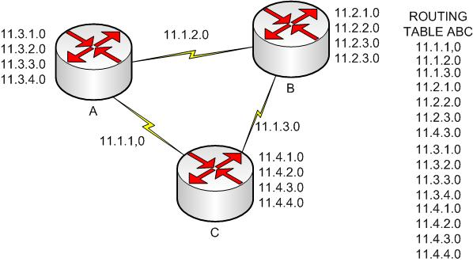
No summarization

Slide 6
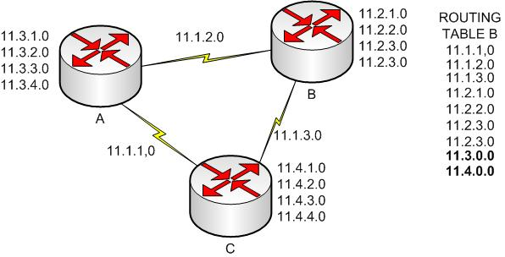
Summarization
Summary routes are configured by network administrators, and configuration differs depending on routing protocol
Subnet choices and contiguous IP addresses are critical
Routers advertise summary routes instead of specifics.

Slide 7
VLSM
VLSM (Variable-Length Subnet Mask)
More than one mask is used within a single class network
Mask bits are allocated to maximize IP utilization
Serial links
Point to Point
/30 255.255.255.252 2^2 -2 = 2 Addresses
LAN
Dependent on No of Hosts
Requirements:
Subnets must not overlap
Subnets must be contiguous
Routing protocol must support VLSM (TX Subnet Number + Mask)
RIPv2, EIGRP & OSPF

Slide 8
Determining “Best” Summary Route
Find Common Part
11.3.1.0 0000 1011 . 0000 0011 . 0000 0001 . 0000 0000
11.3.2.0 0000 1011 . 0000 0011 . 0000 0010 . 0000 0000
11.3.3.0 0000 1011 . 0000 0011 . 0000 0011 . 0000 0000
11.3.4.0 0000 1011 . 0000 0011 . 0000 0100 . 0000 0000
Repeat Common and Fill with 0’s
11.3.0.0 0000 1011 . 0000 0011 . 0000 0000 . 0000 0000
Create Mask that meets common part
255.255.248.0 1111 1111 . 1111 1111 . 1111 1000 . 0000 0000
Verify Range
256-248 = 8 // Networks 0, 8
first IP 11.3.1.1
last IP 11.3.7.254
Broadcast 11.3.7.255

Slide 9
Determining “Best” Summary Route
Find Common Part
11.3.10.0 0000 1011 . 0000 0011 . 0000 1010 . 0000 0000
11.3.11.0 0000 1011 . 0000 0011 . 0000 1011 . 0000 0000
11.3.12.0 0000 1011 . 0000 0011 . 0000 1100 . 0000 0000
11.3.13.0 0000 1011 . 0000 0011 . 0000 1101 . 0000 0000
Repeat Common and Fill with 0’s
11.3.8.0 0000 1011 . 0000 0011 . 0000 1000 . 0000 0000
Create Mask that meets common part
255.255.248.0 1111 1111 . 1111 1111 . 1111 1000 . 0000 0000
Verify Range
256-248 = 8 // Networks 0,8,16
first IP 11.3.8.1
last IP 11.3.15.254
Broadcast 11.3.15.255

Slide 10
Classless and Classful Routing Protocols
Classful
Abide by rules of Class A,B,C
Do not TX mask, just network numbers
SLSM (Static Length Subnet Mask)
Router assumes a mask on basis of local config &/or autosummarization
RIP1 & IGRP
Classless
Not constrained by class rules
TX mask & network numbers
VLSM Support
RIPv2, OSPF & EIGRP

Slide 11
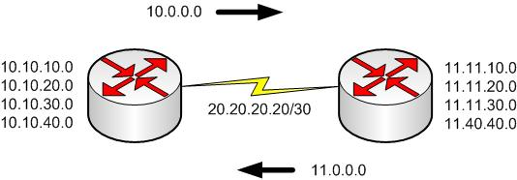
Classless and Classful Routing Protocols
Autosummarization
When a router has interfaces in more than one class A,B or C network,
Routes within “route” updates are summarized when TX to different network.
RIP and IGRP perform it by default and cannot be disabled
RIPv2 can be enabled or disabled.
EIGRP runs it by default but can be disabled as well

Slide 12
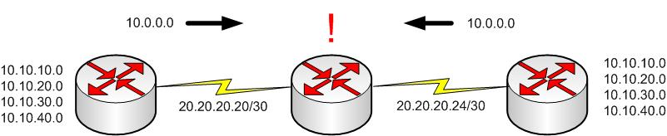
Classless and Classful Routing Protocols
Contiguous and Discontiguous Networks
Classful routing protocols do not support networks with discontiguous networks
Center router will have two output interfaces to same network, load balancing is performed

Slide 13
Classful and classless Routing
Routing
Process of Forwarding IP packets
Classless/Classful
Consider or ignore class rules.
Class concepts are totally independent of the routing protocol.
Classless & Classful routing determine how a router uses a Default route.
Default route
If no route found on routing table packet is discarded
By configuring a Default route, packets are forwarded according to this route (not-discarded)

Slide 14
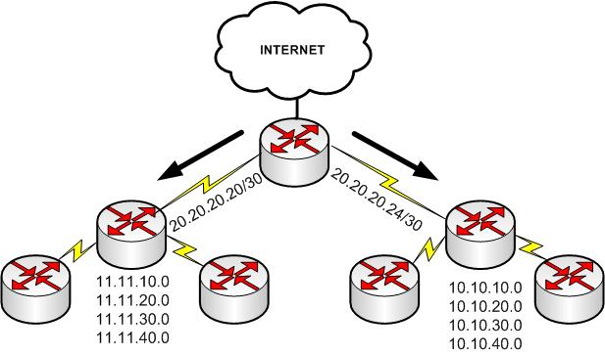
Classful and classless Routing
Default Route (Think Router’s default gateway)

Slide 15
Classful and classless Routing
Default Route
If you don’t have a specific route to a direction, sent it to such IP
Static Route Command
ip route subnet_number subnet_mask next_hop_IP_address
ip route 0.0.0.0 0.0.0.0 Gateway_IP_address
0.0.0.0 0.0.0.0 matches all destinations (by convention)
Propagation by RIP:
show ip route (gateway of last resort)
IP default-network Command
Use it if you have all your subnets in your routing table, and you want to connect to other networks by a default route
Think partial default
ip default-network 10.0.0.0 propagated by central router to 11.0.0.0
show ip route at central displays (* 10.x) as candidate to be default route
show ip at router “11” displays (* 0.x ) as candidate (RIP specific)

Slide 16
Classful and classless Routing
Matching Logic
Classful Routing
Match Class for destination network
If the Class Network is found in routing table
Look for the specific subnet
If NOT found, discard packet
If the Class Network is NOT found in routing table
If Default Route available, use it
Else discard packet
Use default route when a destination Class A,B,C network is not in the routing table
Classless Routing
Look for a specific route to a destination network
If found use route
If NOT found use Default Route

Slide 17
Classful and classless Routing
Selecting Routing type
Global Configuration mode
ip classless (Ignore class rules, use default if not found)
no ip classless

Slide 18
Review for next lecture
Redistribution
Administrative Distance
NAT/PAT
Access Lists

